Slide 1

Tobi Power Innovations(TPI)

Slide 2
Introduction
Aim and Objective
Data Methodology
Research Questions
Key Insights
Challenges
Conclusion

Slide 3
INTRODUCTION
Tobi Power Innovations(TPI) is a regional transmission organization(RTO),which operates within the Western Interconnected grid, delivering electric transmission services across various states
The Power Consumption data, measured in megawatts(MW),is obtained from TPI’s website. It is crucial to acknowledge that regions/companies have evolved over time, affecting data availability for specific dates within each region/company.

Slide 4
AIM AND OBJECTIVE
The aim of this study is to analyze and Optimize power consumption pattern of regions/companies overtime for efficiency, cost savings and sustainability

Slide 5
DATA METHODOLOGY
The Dataset Consists of 12 tables for each region/Company and they have 2 columns each, one is the load in MW, while the other is the date and time at which the load in MW was recorded
The analysis started off with writing an M code from 1998-2018 that creates a table of hourly timestamps between 1998-2018,then the table was merged with all the region/company loads in MW and the rest of the columns were unpivoted except for the date and time column.
The data types were formatted and standardized, duplicates were removed and blank rows were taken care of.

Slide 6
RESEARCH QUESTIONS
Compare Power Consumption across companies – Which company is consuming the most/least energy over a given period
Trend analysis over time – What are the daily or seasonal patterns in energy usage for each company
Identify Peak Power Consumption Periods – Are there specific hours of the day when power consumption spikes

Slide 7
KEY INSIGHTS
The Total Power Consumption across all company/regions is 12bnMW
The average Power Consumption across all company/regions is 11.21k MW
There are a total of 12 regions/companies in the dataset
The Maximum/peak load across each company is 62k MW

Slide 8
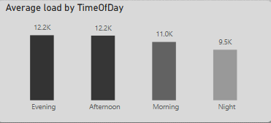
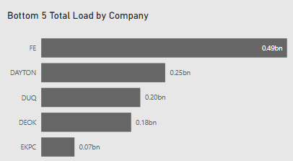
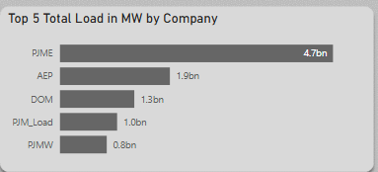
KEY INSIGHTS
The time of the day with the highest power consumption across all regions/companies is the evening, this is because a lot people return from work at this hour leading to a spike in use of electricity, that is the use of light, appliances, charging devices and extended commercial operations.
Region PJME has the highest Power Consumption while Region EKPC has the least Power Consumption across all years

Slide 9
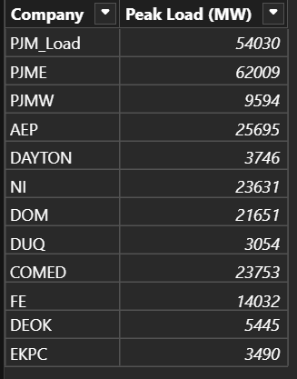
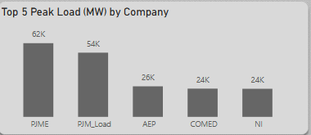
KEY INSIGHTS
The top 5 region/company and their highest peak loads are PJME,PJM_LOAD,AEP,COMED and NI
This could entail that these regions have a spike in energy demand during some specific time of the day
These peaks may reflect industrial operations, high residential density or limited efficiency controls. Understanding these patterns is essential for grid planning and preventing overload

Slide 10
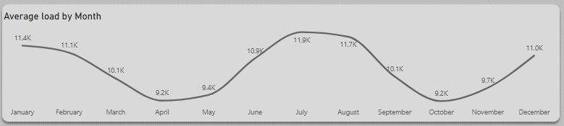
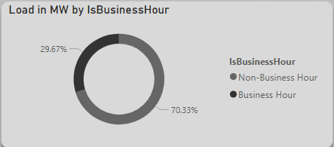
KEY INSIGHTS
There was an all time decrease in power consumption in the month April, May and October this could probably be driven by milder weather conditions reducing the need for air conditioners and possible operation slow down in industrial sectors for mid-year budgeting reviews or preparation for year end holidays. Understanding these seasonal dips can better support demand forecasting and resource allocation.
Non-business hour because people have retired home to rest, there will be increase in appliances use .

Slide 11
RECOMMENDATIONS
Implement load management strategies in High Load consumption regions
Optimize for evening peak demand by charging different electricity rates depending on the time of the day, to encourage peopleto use power when demand is lower
Promote Energy efficiency Programs in order to reduce cost and environmental impacts
Plan for seasonal demand dips to reduce over supply of energy and use these periods for grid maintenance and servicing

Slide 12
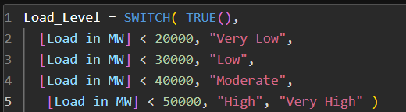
CHALLENGES
The region/company PJM Spanned from the year 1998-2002 this was a challenge while working with the dataset especially while merging the dataset so none will be left out.
Meanwhile, PJME and PJMW started from year 2002 and spanned across the years
While the rest started from 2004 and spanned through to 2018
The dataset lacked some specific information, calculated columns were created so the users could better understand the dataset.

Slide 13
CONCLUSION
Overall, these insights highlight the importance of time-based, region-specific, and seasonal factors in shaping energy demand. They underscore the need for:
Load forecasting and demand response strategies
Energy efficiency initiatives in peak regions
Data-driven planning to optimize resource use across different times of day and year
These findings provide a foundation for Tobi Power Innovations to enhance grid reliability, reduce operational costs, and support sustainable energy management

